Slide 1


Analysis of Factors Impacting Mortality Risk

Slide 2


Project Goals
Objectives
Constraints
Mortality Risk differs due to combination of diseases.
Limited data availability of certain features as most of the features tend to be constant value columns.
Perform EDA on the mortality dataset and selecting the best features that have significant impact on mortality risk rate.
Assessment of the impact of different factors on Mortality Risk in the form of plots

Slide 3
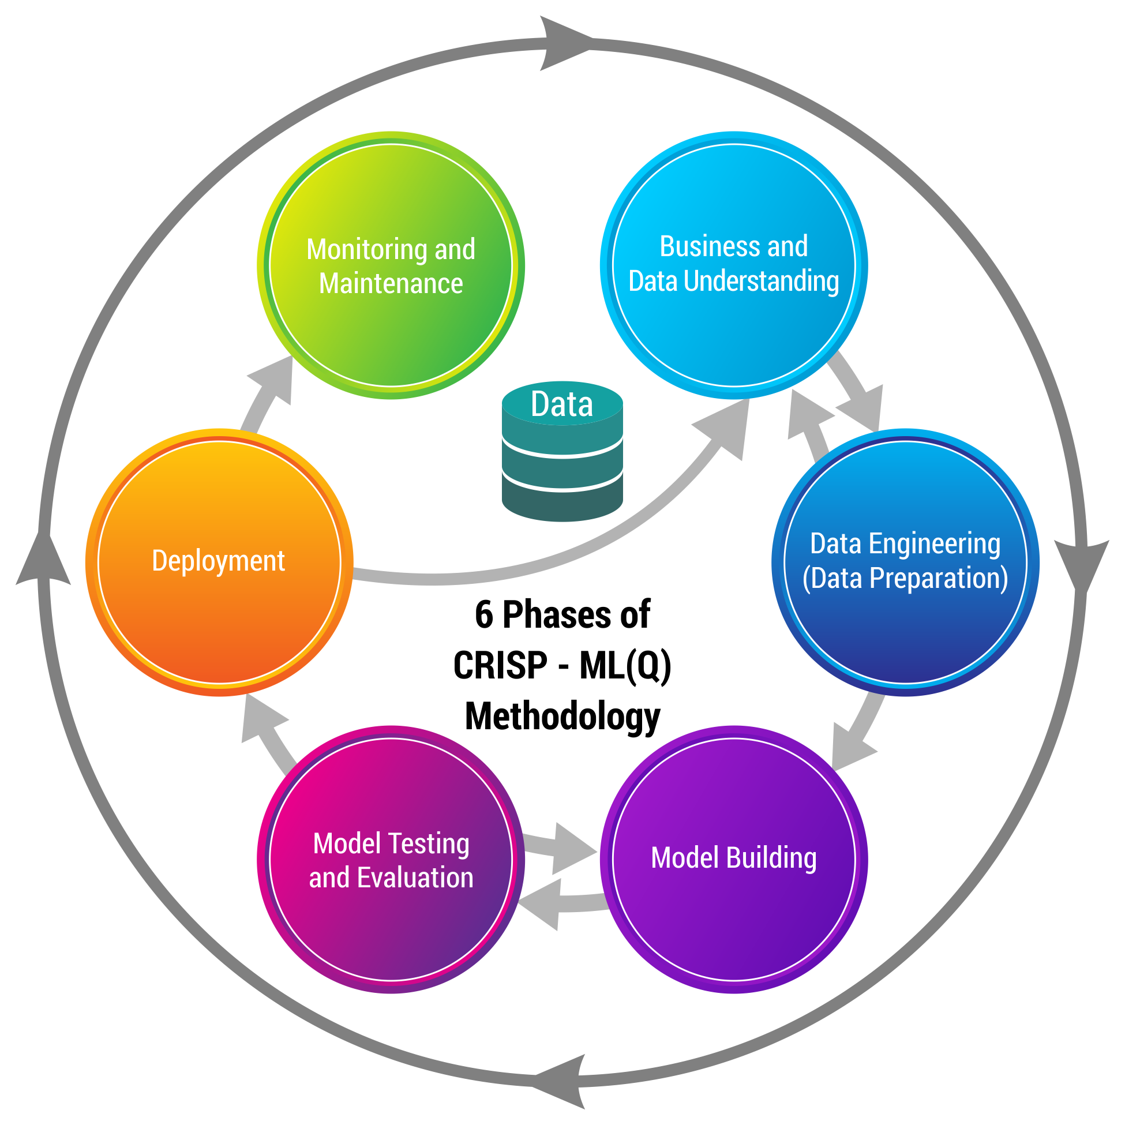
Business pipeline: CRISP-ML(Q) Methodology

Slide 4





Technical Stacks
We have done programming in Python in Google Colab Environment.
Within Python, we used packages like pandas, numpy, matplotlib, seaborn, sklearn.feature_selection.
For visualizations, Python, Microsoft PowerBI, Tableau, matplotlib package & seaborn package were used.

Slide 5
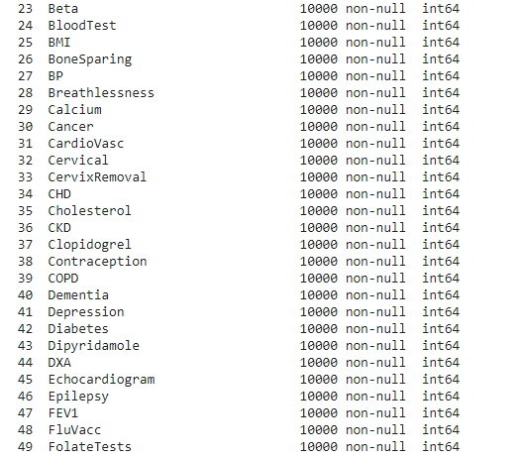
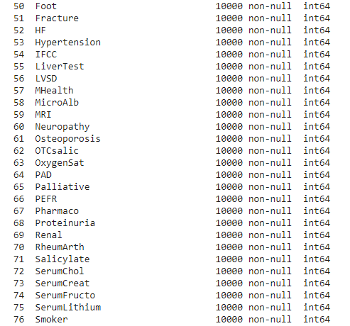
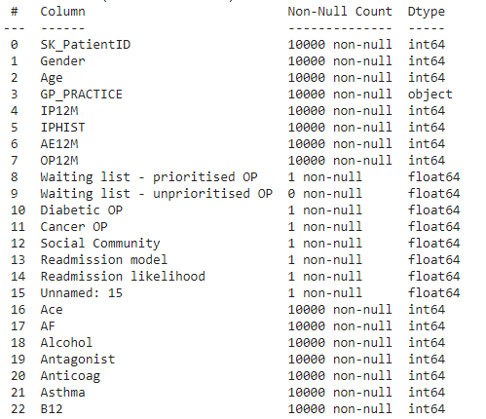
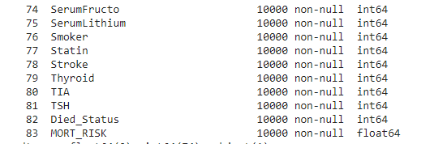
Project Architecture / Data Pipeline
Dataset dytpes and columns are being shown.
The dataset contains 10000 rows and 84 columns.
We summarize the contents of the dataset given before EDA.

Slide 6
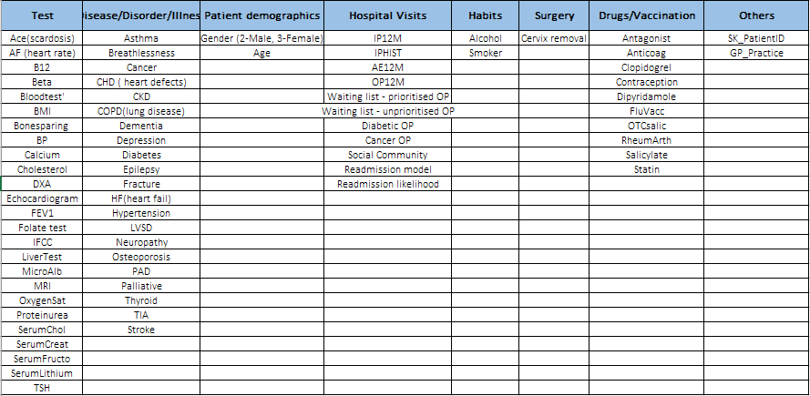

Slide 7

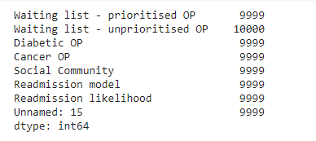
Data Preparation
Data used for training the model contains 10000 rows and 84 columns.
Data cleansing: Columns containing null values were removed. From the given data, 8 columns have 9999 null values each. They were removed.
There are no outliers in the given data as most of the data provided is categorical. Columns containing numerical data do not have outliers. Hence, outlier treatment is not necessary.
Data splitting is not necessary here as we are trying to understand what factors primarily influence mortality risk rather than predicting/classifying a variable.
Null Values

Slide 8
Identifying Numerical, Text & Categorical Columns
Numerical Columns: IPHIST, IP12M, AE12M, OP12M (These columns are irrelevant as these deal with the patient visit history)
String Column: Patient ID (Irrelevant)
Categorical Columns: Diseases & Various Medical Tests are represented in binary categories indicating the presence or absence of the disease or test
Target Column: MORT_RISK (Numerical)
12

Slide 9
Important Observation on Mortality Risk Column!
Only the first 120 rows of Mortality Risk column have entries greater than 0.1. Hence, one must give special weightage to the diseases that are contributing to the Mortality Risk in the first 120 rows
The first 120 patients have many diseases present at once. The best solution would be to find commonalities across all the approaches used in the previous slides and give a conclusion on feature importance.
12

Slide 10

Feature Importance

Slide 11
Assessment of Disease Impact on Mortality Risk
Impact of diseases on mortality risk is assessed using 2 different approaches: Approach 1: Impact of individual disease is estimated
Approach 2: Impact of diseases on a particular age group & gender is estimated
The important columns that have a strong impact on Mortality Risk are as follows:
Ace 9. HF
AF 10. OTCSalic
Antagonist 11. OxygenSat
Anticoag 12. Palliative
Breathlessness 13. Salicylate
Cancer 14. BoneSparing
CHD 15. Dementia
CKD
12
Notes:
8,9,10,11 – Raghu PPT Slides
13-21: Decide accordingly for individual disease scenario

Slide 12
Individual Disease
Impact

Slide 13
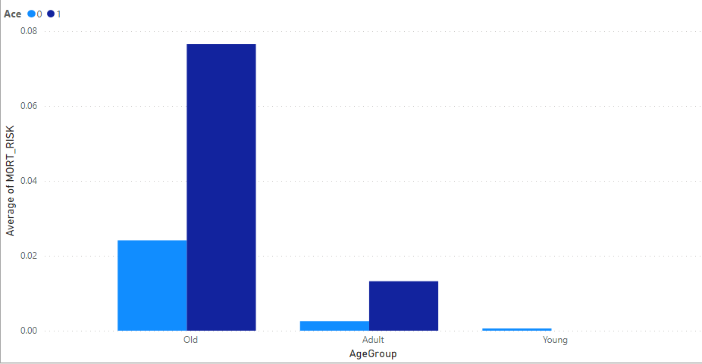
Average of MORT_RISK by Age Group and Ace
11​
Notes:
Interpretation: Ace Column seems to play a decent role in increase of Mortality Risk due to the huge difference between presence & absence of disease. It could be due to other diseases, but the difference is quite significant for this column

Slide 14
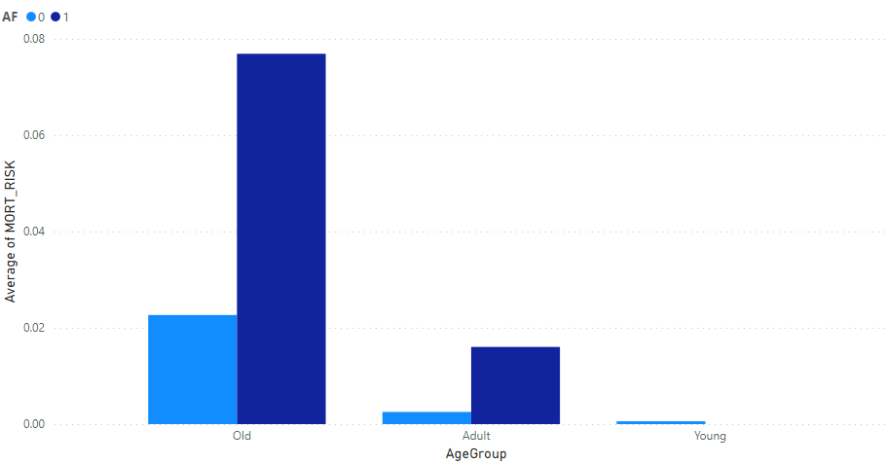
Average of MORT_RISK by Age Group and AF
11​
Notes:
Interpretation: AF Column seems to play a decent role in increase of Mortality Risk due to the huge difference between presence & absence of disease. It could be due to other diseases, but the difference is quite significant for this column

Slide 15
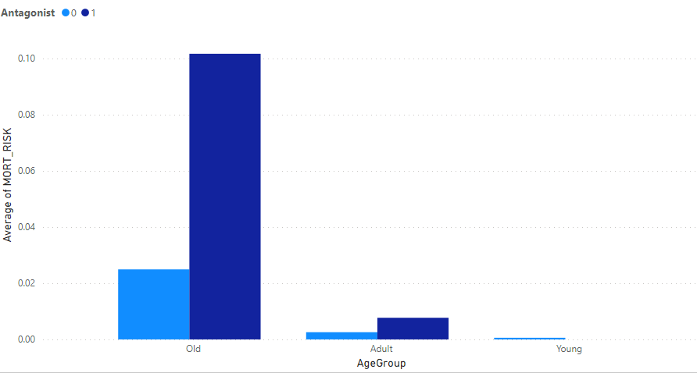
Average of MORT_RISK by Age Group and Antagonist
11​
Notes:
Interpretation: Antagonist Column seems to play a decent role in increase of Mortality Risk due to the huge difference between presence & absence of disease. It could be due to other diseases, but the difference is quite significant for this column

Slide 16
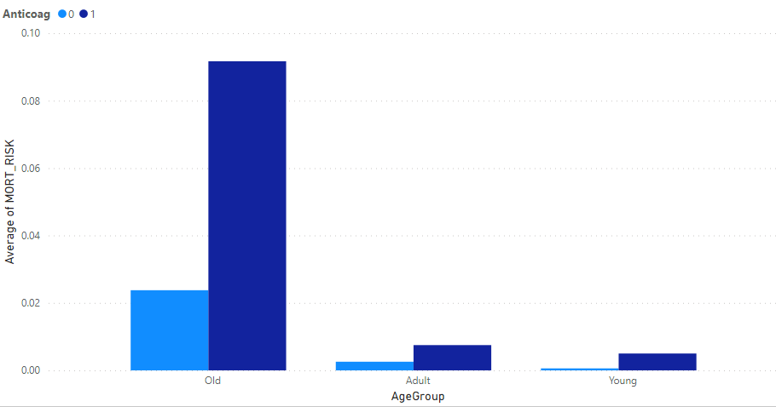
Average of MORT_RISK by Age Group and Anticoag
11​
Notes:
Interpretation: Anticoag Column seems to play a decent role in increase of Mortality Risk due to the huge difference between presence & absence of disease. It could be due to other diseases, but the difference is quite significant for this column

Slide 17
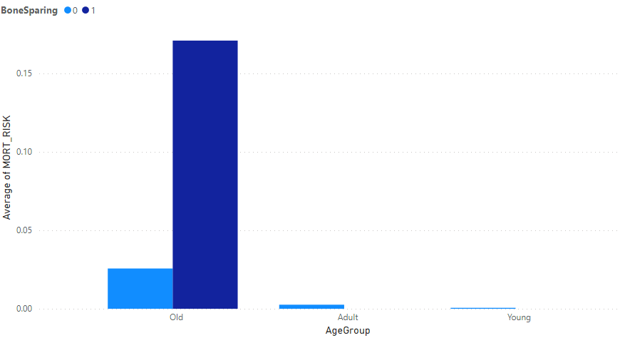
Average of MORT_RISK by Age Group and BoneSparing
11​
Notes:
Interpretation: B12 Column seems to play a mediocre role in increase of Mortality Risk due to the mediocre difference between presence & absence of disease.

Slide 18
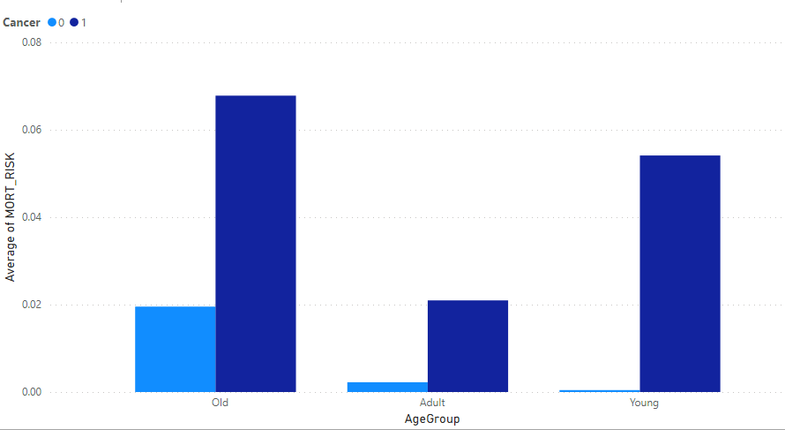
Average of MORT_RISK by Age Group and Cancer
11​
Notes:
Interpretation: B12 Column seems to play a mediocre role in increase of Mortality Risk due to the mediocre difference between presence & absence of disease.

Slide 19
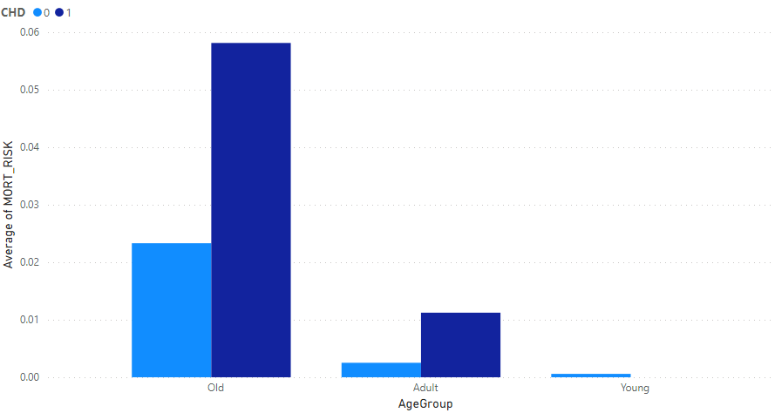
Average of MORT_RISK by Age Group and CHD
11​
Notes:
Interpretation: B12 Column seems to play a mediocre role in increase of Mortality Risk due to the mediocre difference between presence & absence of disease.

Slide 20
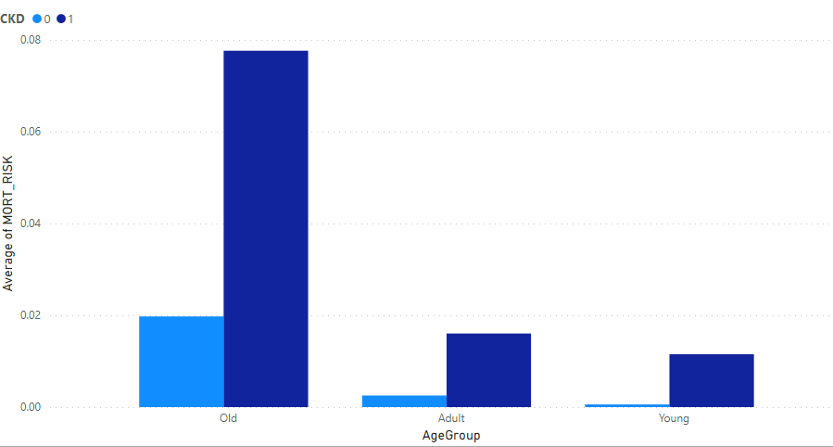
Average of MORT_RISK by Age Group and CKD
11​
Notes:
Interpretation: B12 Column seems to play a mediocre role in increase of Mortality Risk due to the mediocre difference between presence & absence of disease.

Slide 21
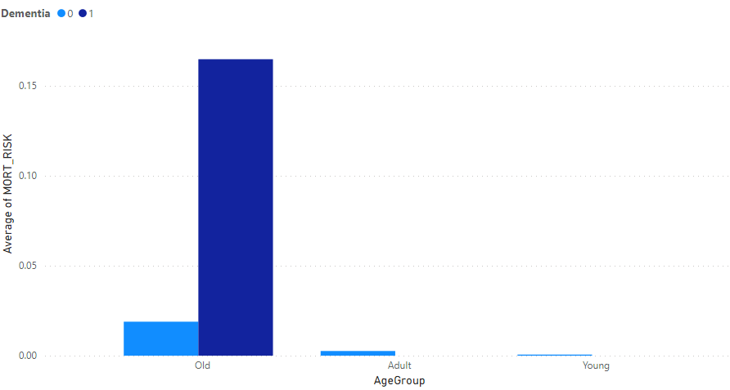
Average of MORT_RISK by Age Group and Dementia
11​
Notes:
Interpretation: B12 Column seems to play a mediocre role in increase of Mortality Risk due to the mediocre difference between presence & absence of disease.

Slide 22
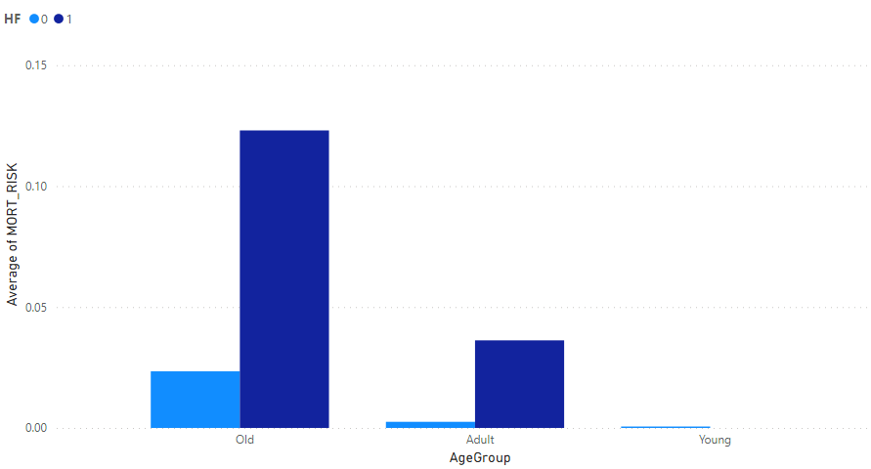
Average of MORT_RISK by Age Group and HF
11​
Notes:
Interpretation: B12 Column seems to play a mediocre role in increase of Mortality Risk due to the mediocre difference between presence & absence of disease.

Slide 23
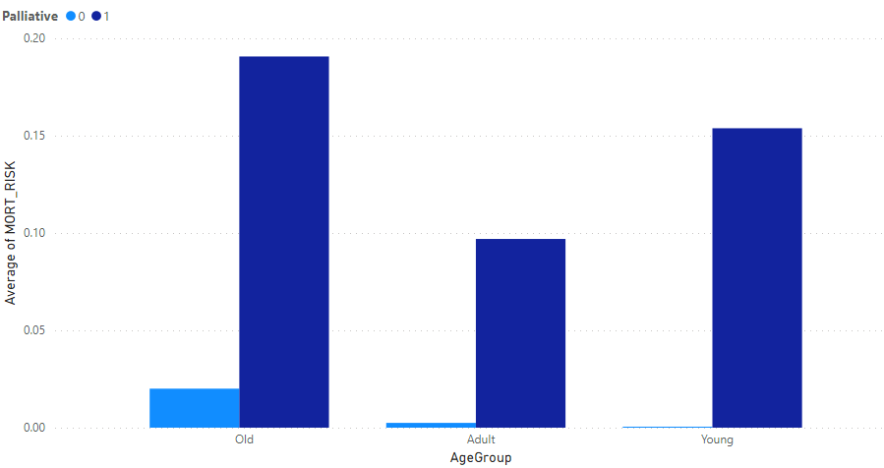
Average of MORT_RISK by Age Group and Palliative
11​
Notes:
Interpretation: B12 Column seems to play a mediocre role in increase of Mortality Risk due to the mediocre difference between presence & absence of disease.

Slide 24
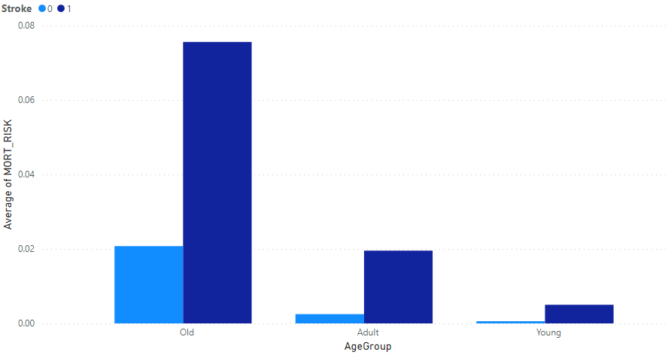
Average of MORT_RISK by Age Group and Stroke
11​
Notes:
Interpretation: B12 Column seems to play a mediocre role in increase of Mortality Risk due to the mediocre difference between presence & absence of disease.

Slide 25
Inferences from Visualizations of Approach 1
Color Coding: Light Blue indicates non-occurrence of a disease and Dark Blue indicates occurrence of a disease
In cases where the entry for a given column is 0, we are clear that the given disease (or column) has no contribution
In cases where the entry for a given column is 1, we are unsure whether a particular disease is solely contributing to mortality risk, or a combination of diseases is contributing to mortality risk
In this case, we go by combining all the approaches we have taken so far and approach a conclusion.
12

Slide 26
Impact on Age Group & Gender

Slide 27
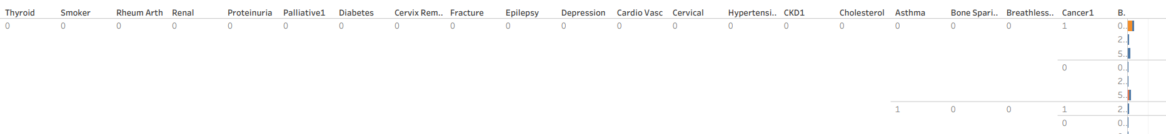
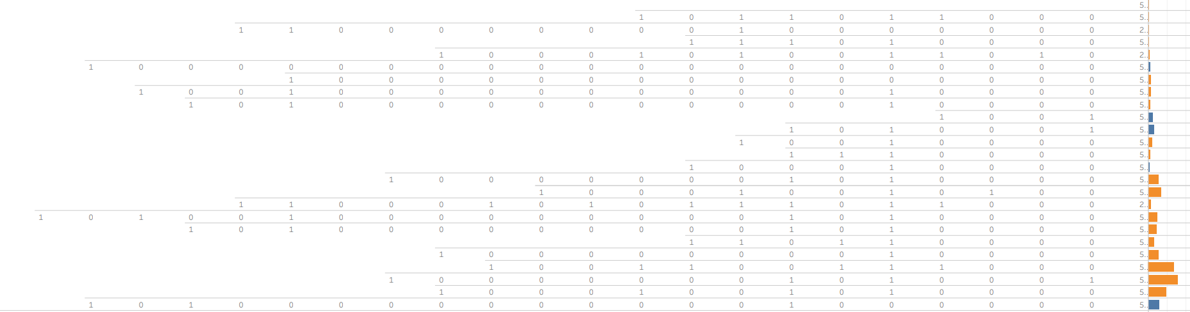
Visualization

Slide 28
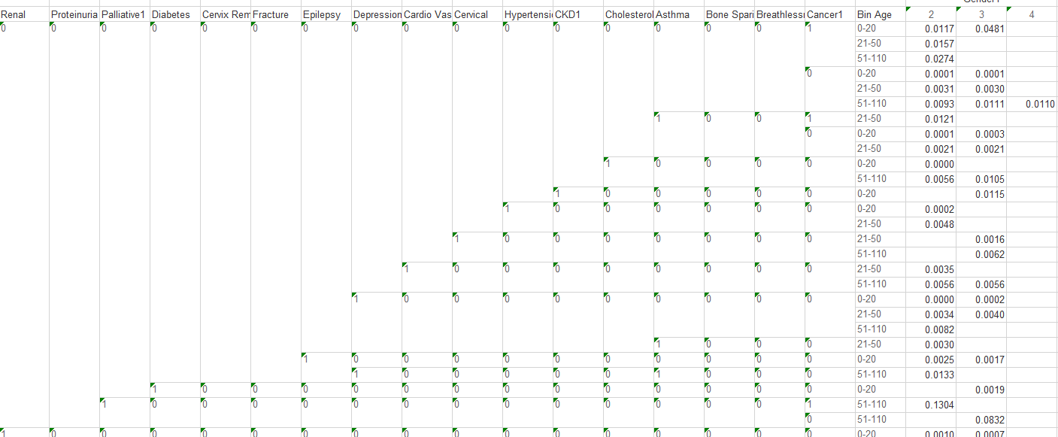
Numeric Representation

Slide 29
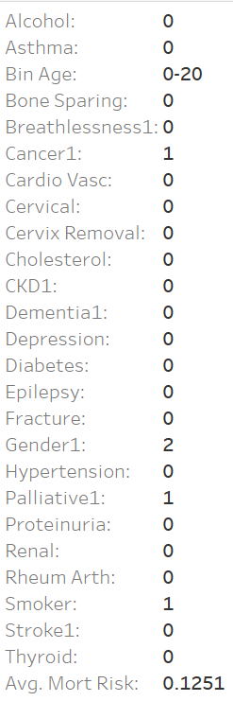
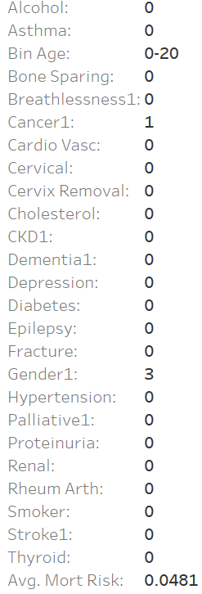
Visualization inference
Please find the visualization and cross tab from pdf and excel file respectively.
Highest avg mort risk with Diseases cancer, palliative along with smoking of gender Male and age group 0-20 is 12.51%
Highest avg mort risk with Diseases cancer, palliative along with smoking of gender Female and age group 0-20 is 4.81%

Slide 30
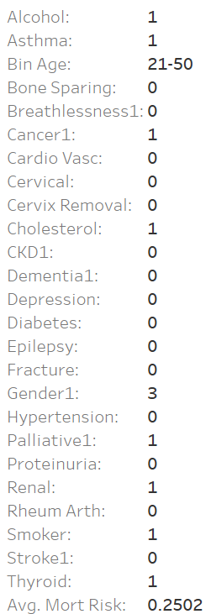
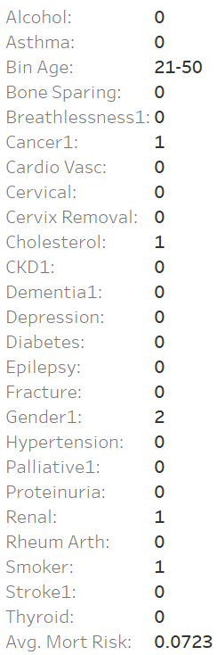
Inference Cont..
Highest avg mort risk with Diseases asthma, cancer, cholesterol, palliative , Renal , thyroid along with smoking and alcohol consumption of gender Female and age group 21-50 is 25.02%
Highest avg mort risk with diseases cancer, cholesterol, palliative , Renal along with smoking and of gender Male and age group 21-50 is 7.23%

Slide 31
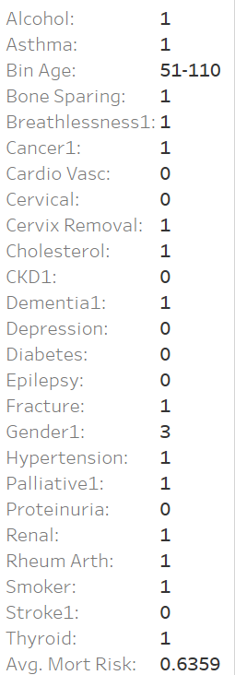
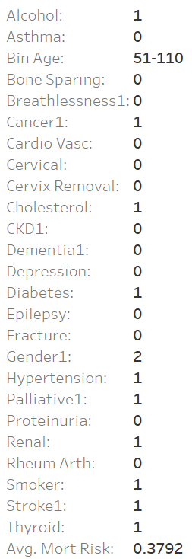
Inference cont..
Highest avg mort risk with diseases asthma, bone sparing, breathlessness, cancer, cholesterol, cervix removal, dementia , fracture , palliative , hypertension , Renal , rheum arth , thyroid along with smoking and alcohol consumption and of gender Female and age group 51-110 is 63.59%
Highest avg mort risk with diseases cancer, cholesterol, palliative , diabetes, hypertension , Renal , stroke , thyroid along with smoking and of gender Male and age group 51-110 is 37.92%

Slide 32
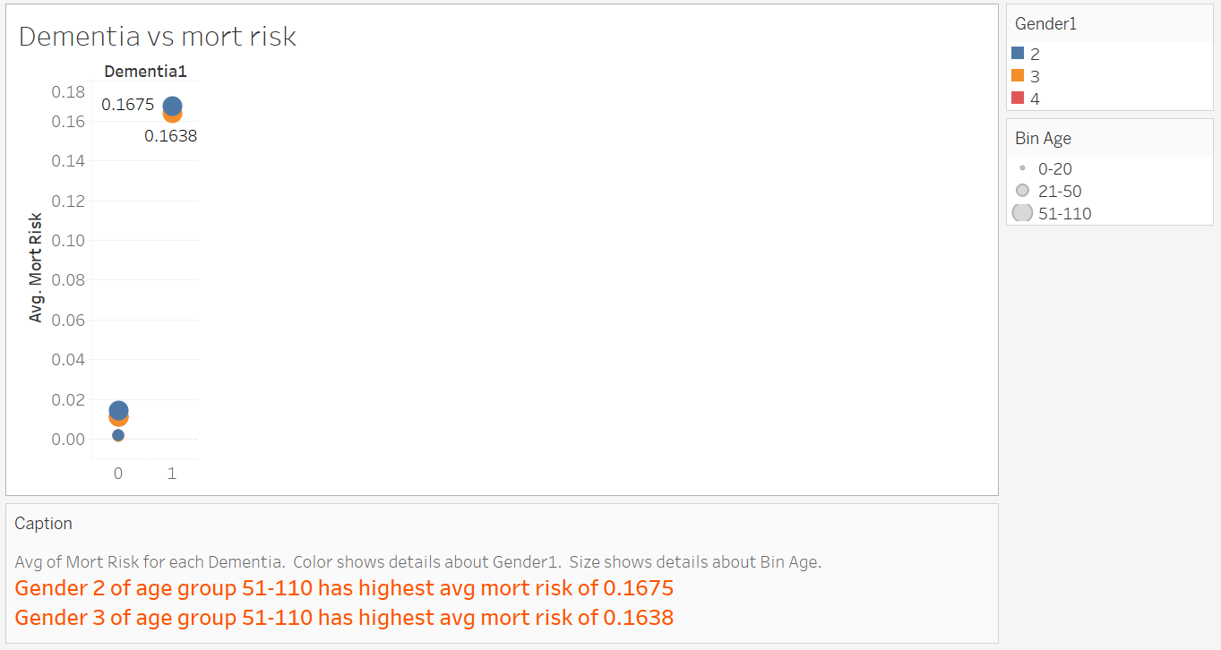
Feature analysis

Slide 33
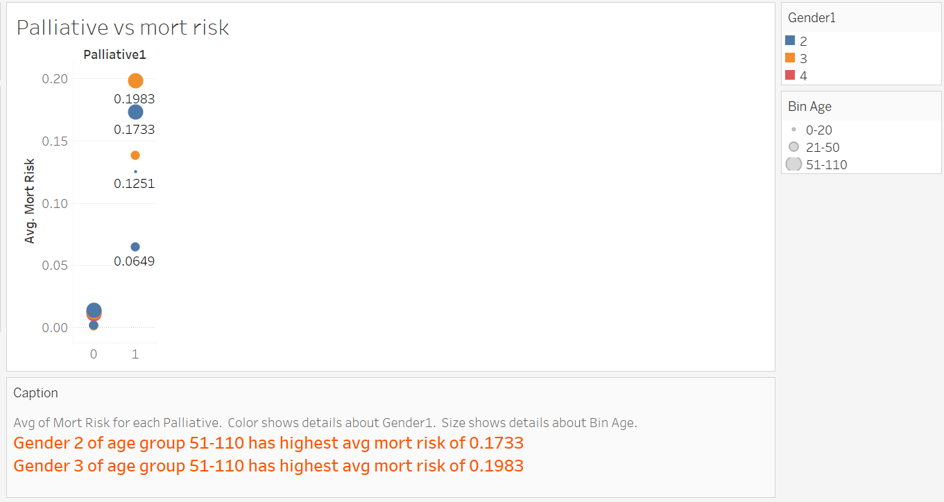
Cont…

Slide 34
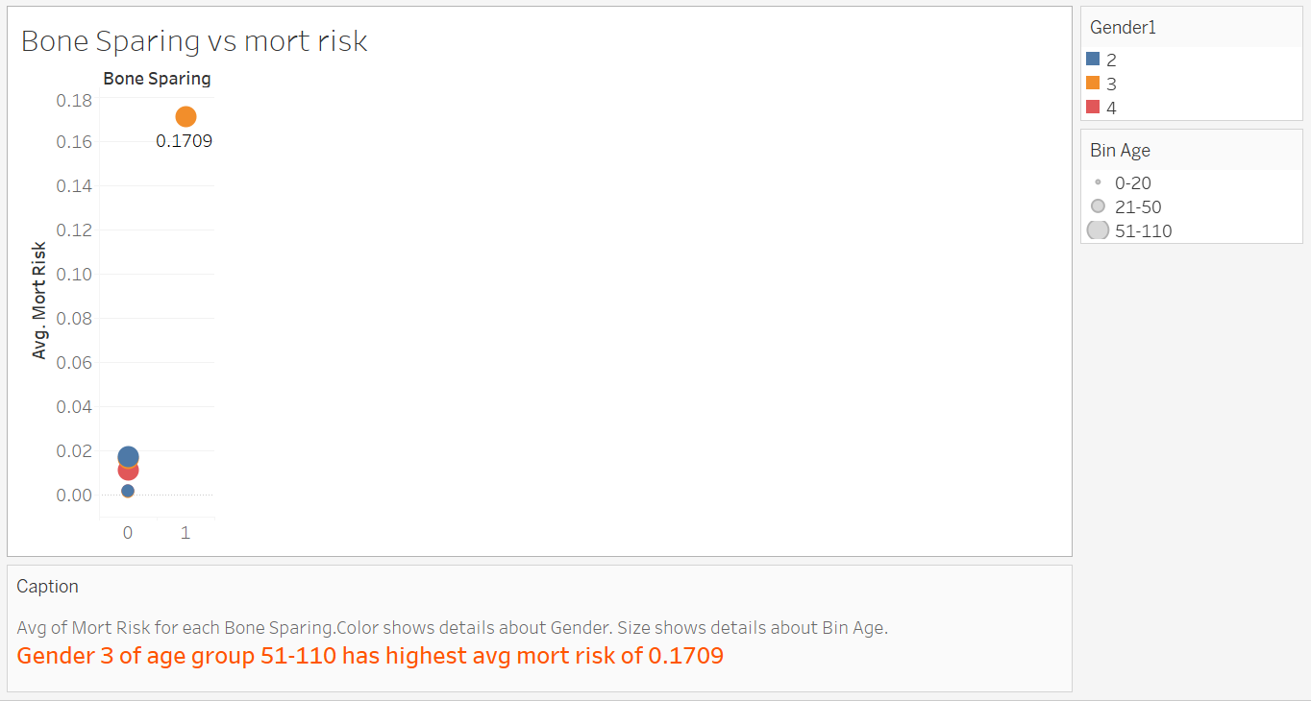
Cont…

Slide 35
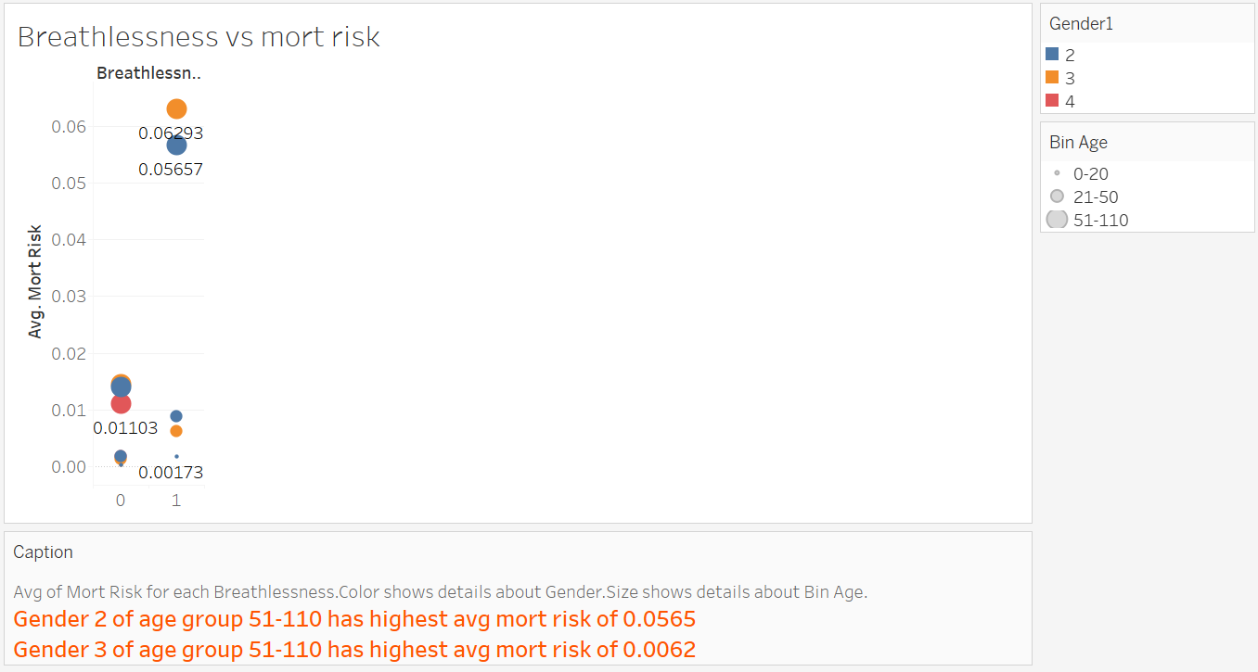
Cont…

Slide 36
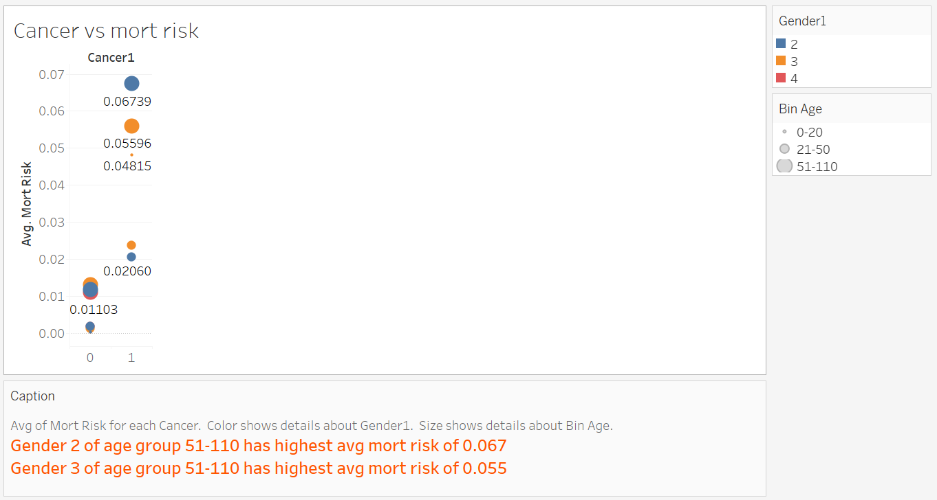
Cont…

Slide 37
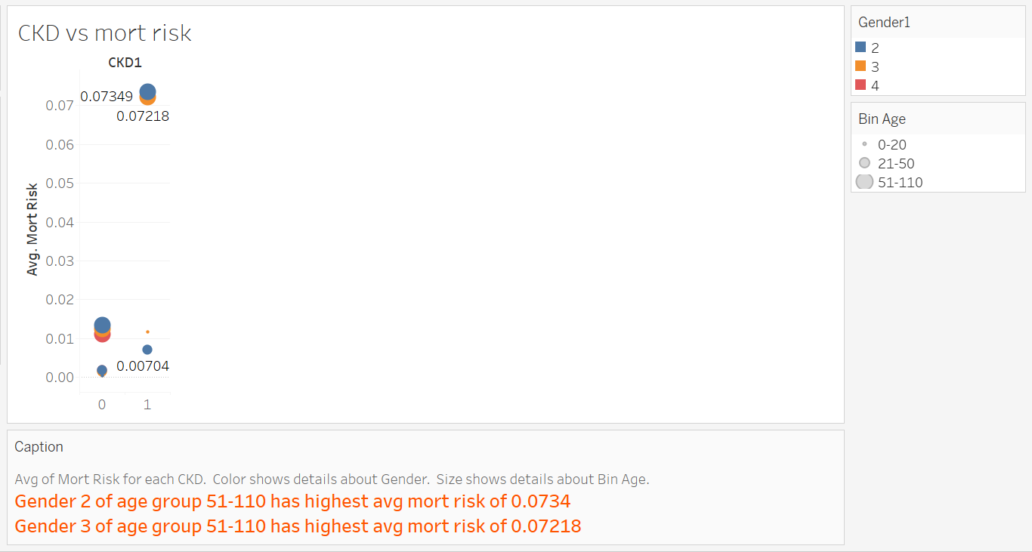
Cont…

Slide 38
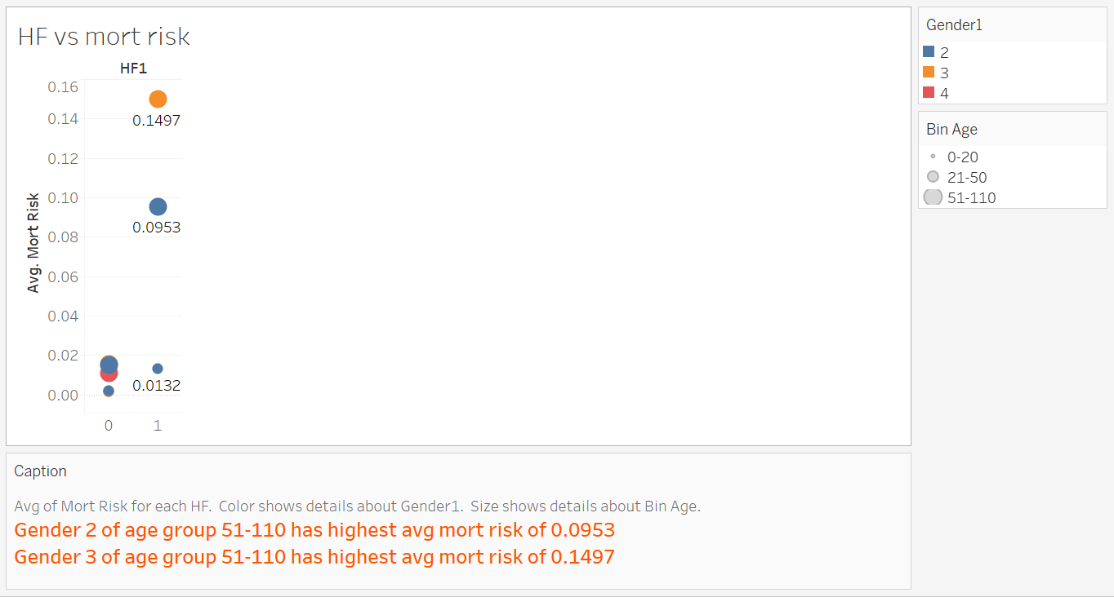
Cont…

Slide 39
Feature Selection

Slide 40
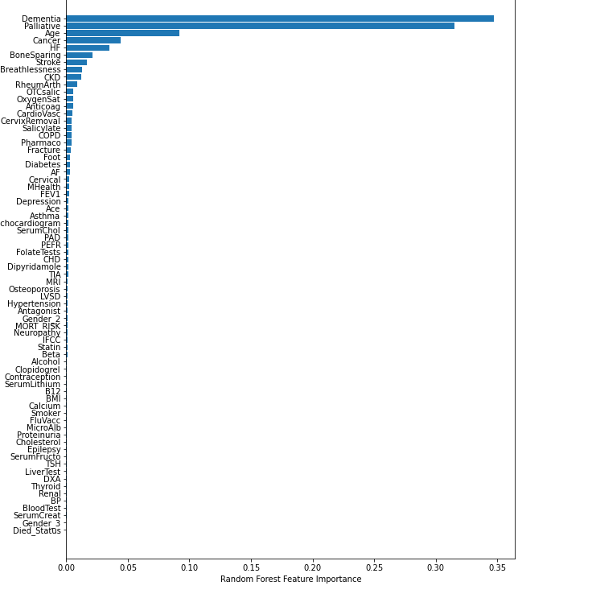
Feature Importance plot
Using random forest regressor found top 10 disease that influences mortality risk with RMSE value 0.009865.
Are Dementia, Palliative, Age, Cancer ,Bone Sparring, Stroke , Breathlessness, Ckd, Rheum Arth

Slide 41
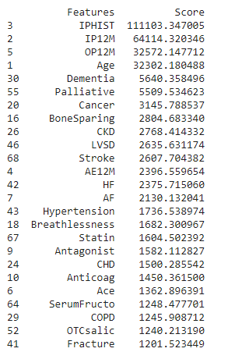
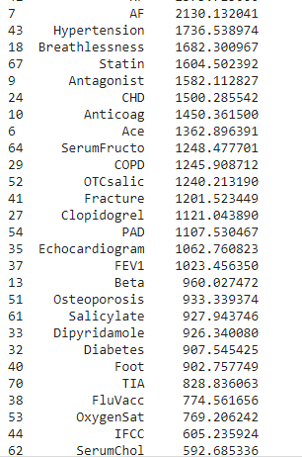
KBest Features Approach
11​

Slide 42
Comparison of Model Performance
Models | Feature Importance | KBest Features
Root Mean Square Error (RMSE) | 0.009865 | 0.0081
Performance | Takes few seconds to give predictions | Takes few seconds to give predictions

Slide 43
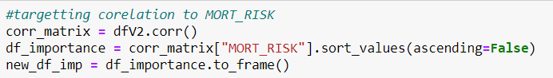
Pearson Correlation Based Approach
Calculated correlation matrix for dataset.
Targeted MORT_RISK columns against other features and converted that to dataframe.
Compared results with KBest approach and observed similar results.
12

Slide 44
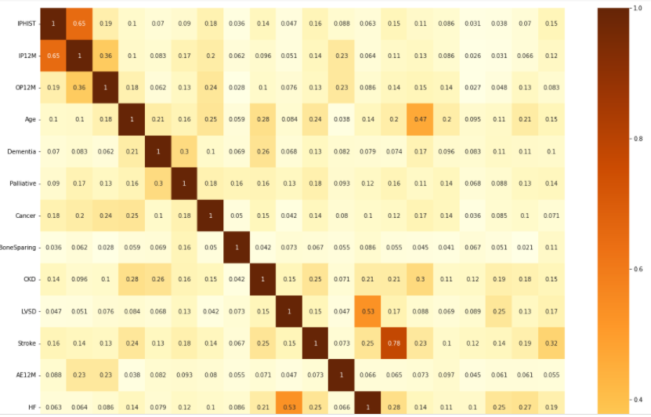
Correlation Heat Map
11​

Slide 45
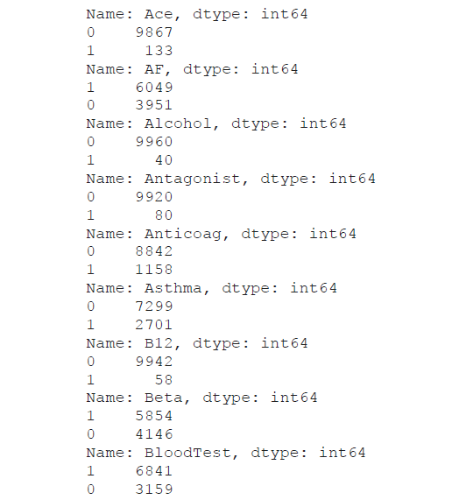
Feature Elimination Method using value_counts() function
Feature Columns where maximum entries lean more towards one category (>9900) have to be assessed carefully
35 features are showing this trend. Hence, they could be assessed only through taking commonalities across different approaches
12

Slide 46
Top 10 Diseases: Dementia, Palliative , Age , Stroke , CKD , HF , Bone Sparing, Breathlessness , Cancer.
Top Impactors: Dementia and Palliative are the 2 features which have highest have mort risk 16.75% and 19.83%.
Assessment on Age Groups: 51-110 (Old) age group people have high avg mort risk.
Assessment on Gender: Out of the above 9 diseases, 6 diseases were predominant in women, so they are more prone to life risk.
FINAL INFERENCES

Slide 47


